Slide 1

DEFENCE SERVICES ACADEMY
M.Sc (21th Batch) Computer Science
DEPARTMENT OF COMPUTER SCIENCE
Pyin Oo Lwin
Notes:
Good Afternoon! Honorable and invited guests, all of my Lecturers, supervisor and my batch friends.

Slide 2
IMPLEMENTATION OF AUTOMATED DYNAMIC WEAPON RANGE VISUALIZATION AND ENGAGAEMENT PLANNING FOR MILITARY TACTICAL SUPPORT SYSTEM USING GEOSPATIAL DATA
Presented by
Captain Aung Nyi Nyi Min
M.Sc (21th Batch)
Supervisor Lt.Col Zar Nay Lin
Co-supervisor Major Zin Min Thu
2
Notes:
Firstly, May I introduce myself.
I'm Captain Aung Nyi Nyi min, and Master Candidate at Department of Computer Science.
Today I' would like to present my thesis work.
The title of my thesis is “Golf Score Management System with PHP Laravel Framework” .
And my supervisor is Lt.Col Zar Nay Lin, and Co-supervisor is Zin Min Thu.

Slide 3
Outlines
Abstract
Introduction
Aim of Thesis
Objectives of Thesis
Problem Statement
Background Theories
Conclusion
3
Notes:
OK! First of all, I would like to present outlines of my thesis.
In this seminar, I will present our thesis as these program. And generally divided by 7 state.
First stage is the abstract of our thesis.
Second stage is the Introduction of our thesis.
Third stage is the Aim of our thesis.
Fourth stage is the Objectives of our thesis.
Fifth is the Problem Statement .
Sixth is the Scope of thesis and background theory.
Finally, is the conclusion of our thesis.

Slide 4
Abstract
The system automates the process of mapping current and target locations, measuring distances, and visualizing weapon ranges based on their power and specifications.
The system integrates various APIs to retrieve real-time geolocation data and converts geographic coordinates to the Military Grid Reference System (MGRS) for accurate positioning.
The system calculates the distance from the current location to the desired target, visualizes the effective firing ranges on interactive maps, and identifies the optimal troops and weapons for engagement based on proximity and ammunition requirements.
4
Notes:
In this slides, May I present about the abstract of my thesis.

Slide 5
Introduction
In the realm of modern warfare, the precision and efficiency of tactical operations are paramount to mission success.
Traditional methods of planning and executing tactical operations are often time-consuming and prone to human error, necessitating the development of automated systems that can enhance decision-making processes.
The system supports the ability to quickly and accurately determine the positioning of forces, calculate engagement ranges, and optimize resource allocation can significantly impact the outcome of military engagements.
5
Notes:
Now I would like to present the introduction of system.

Slide 6
Aim of my thesis
The primary aim of this thesis is to develop an automated system that supports military tactical planning by dynamically visualizing weapon firing ranges and optimizing engagement strategies using real-time geospatial data. This system is designed to improve the efficiency and accuracy of military operations, ultimately contributing to mission success.
6
Notes:
Now I would like to present the Aim of my thesis

Slide 7
Objectives
To integrate APIs for retrieving real-time geolocation data
To implement algorithms that accurately measure distances between current and target locations
To develop a visualization module based on weapon specifications.
To create algorithms that identify optimal troops and weapons
To design an intuitive user interface
To conduct extensive testing with simulated and real-world data to ensure the system's accuracy, reliability, and practical utility.
7
Notes:
And then I would like to present the objectives of our thesis.

Slide 8
Problem Statement
In modern military, effective tactical planning and resource allocation are critical for mission success and minimizing collateral damage.
The current methods of tactical planning are time-consuming, prone to human error, and lack the agility required for real-time decision-making.
This thesis aims to develop an Automated TDSS that integrates real-time geospatial data, advanced algorithms, and intuitive visualizations to enhance tactical planning.
8
Notes:
And then I would like to present the problem statement of system.

Slide 9
Background Theory
Flutter
Web API
Hyper Text Transfer Protocol (HTTP)
Personal Home Page or Hypertext Preprocessor (PHP)
Relational Database Management System (RDBMS)
MySQL Database Server
GIS
Tactical Decision Support System (TDSS)
Military Grid Reference System (MGRS)
Algorithm for LatLng to MGRS Conversion
9
Notes:
In this slide, I would like to present the background thoery of system.

Slide 10
Flutter Architecture
Flutter is Google's portable UI toolkit for crafting beautiful, natively compiled applications for mobile, web, and desktop from a single codebase. Flutter works with existing code, is used by developers and organizations around the world, and is free and open source. Below is a general overview of key components and considerations in Flutter architecture-
Client-Side (Frontend)
Server-Side (Backend)
Database Management System (DBMS)
Application Programming Interface (API)
10
Notes:
In this slide, I would like to present the flutter architecture

Slide 11
Client-Side(Frontend)
The client-side, also known as the frontend, is the part of an application that users interact with directly.
User Interface (UI): DART Language, Flutter Package
Device: IOS, Android.
Frameworks and Libraries:
Flutter Dart libraries, Skia graphics library
Widget tree
Android Studio
Java SDK (Software Development Kit)
11

Slide 12
Server-Side(Backend)
The server-side, or backend, of an application is responsible for handling tasks that don't involve direct interaction with the user but are crucial for the functionality and data management of the application.
Application: Flutter, Awardspace
Database: MySQL, PostgreSQL, MongoDB, SQLite, Oracle
API (Application Programming Interface)
Middleware
Authentication and Authorization
Server-Side Languages: PHP, DART etc.
12

Slide 13
Flutter Application
Flutter is an open-source UI software development kit created by Google.
It can be used to develop cross platform applications from a single codebase for the web, Fuchsia, Android, iOS, Linux, macOS, and Windows.
Dart is optimized for building UIs, and many of Dart’s strengths are used in Flutter.
The embedder is responsible for launching the Flutter engine and integrating it with the native OS.
13

Slide 14
Advantages of Using Flutter
There are advantages that Flutter stands out as a cross-platform development framework:
Close-to-native performance
Fast, consistent, and customizable rendering.
Developer-friendly tools.
14

Slide 15
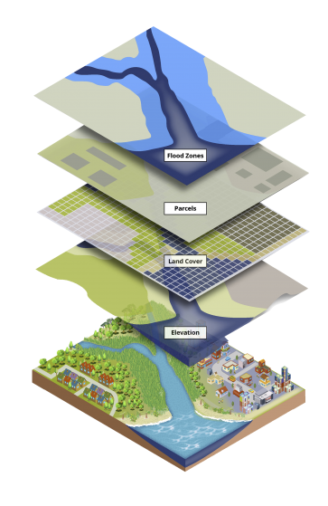
Geospatial Information Systems (GIS)
Geospatial Information Systems (GIS) represent a pivotal technology in the realm of spatial data management and analysis. GIS integrates hardware, software, and data for capturing, managing, analyzing, and displaying all forms of geographically referenced information. This technology has become indispensable across various disciplines, including urban planning, environmental management, logistics, epidemiology, natural resource management, and of course, military operations.
15

Slide 16
Components of GIS
GIS comprises several fundamental components:
Hardware: This includes GPS receivers, satellite imagery sensors, and other data acquisition tools used to collect geographic data.
Software: GIS software provides the tools for data storage, analysis, and visualization. Examples include ArcGIS, QGIS, and Google Earth Engine.
Data: Geospatial data includes geographic features (points, lines, polygons), attributes associated with these features, and imagery collected from various sources.
.
16

Slide 17
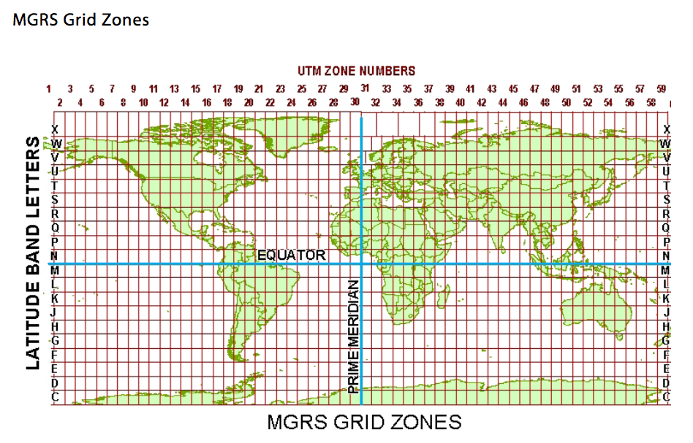
Military Grid Reference System (MGRS)
The Military Grid Reference System (MGRS) is a geographic coordinate system used extensively by military forces worldwide for locating points on the Earth's surface. It is based on the Universal Transverse Mercator (UTM) coordinate system but provides a more concise and standardized method of representing geographic coordinates. MGRS divides the Earth's surface into a grid of zones, each identified by a unique combination of zone number, zone letter, grid square identifier, and numerical location identifier.
17

Slide 18
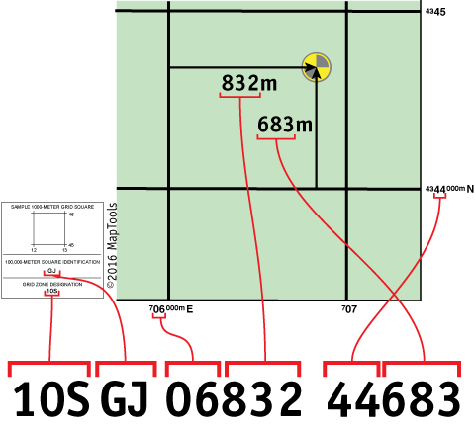
LatLng to MGRS Conversion
The conversion from LatLng (latitude, longitude) to MGRS involves several steps, including:
Convert LatLng to UTM (Universal Transverse Mercator) coordinates
Determine the UTM zone
Convert UTM to MGRS
18

Slide 19
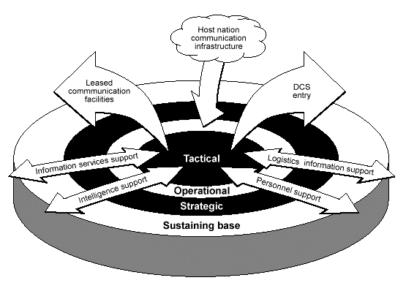
Tactical Decision Support System (TDSS)
A Tactical Decision Support System (TDSS) is a specialized software application designed to assist military commanders and decision-makers in making informed decisions during tactical operations. It integrates various data sources, analytical tools, and visualization techniques to provide real-time situational awareness and actionable insights.
19

Slide 20
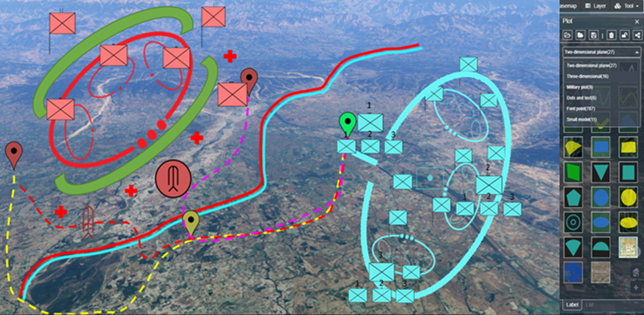
General Equations and Algorithms Used in TDSS
Distance Calculation
Route Planning
Weapon Firing Solutions
Spatial Analysis
20

Slide 21
Proposed System Design
Transfer)
21

Slide 22
Overall Design of the System
22

Slide 23
Conclusion
This system supports an Automated Military Tactical Support System, designed to leverage advancements in Geospatial Information Systems (GIS) and algorithmic optimization to provide dynamic visualizations of weapon firing ranges and comprehensive engagement planning.
It also supports to automate the process of retrieving location data, measuring distances, visualizing weapon ranges, and calculating optimal engagement strategies, thereby providing military personnel with a robust tool for more precise and effective decision-making.
23

Slide 24
Any Suggestions?

Slide 25
Thank You
Notes:
Thank you for your kind attention.

Slide 26
“ The Telegraph to Cyber Text in Telegraphing of Upper Department and Subordinates using Advanced Encryption Standard (AES) Model ”
“ Online Food Delivery Service with Real-time Order Tracking using GPS Tracking and Push Notification Services Integration ”
26

